Slide 1
Spark SQL: Relational Data Processing in Spark
SIGMOD 2015
Michael Armbrusty, Reynold S. Xiny, Cheng Liany, Yin Huaiy, Davies Liuy, Joseph K. Bradleyy, Xiangrui Mengy, Tomer Kaftanz, Michael J. Franklinyz, Ali Ghodsiy, Matei Zahariay
DataBricks & AMPLab UC,Berkeley
Presenter:
Arjun Prakash

Slide 2
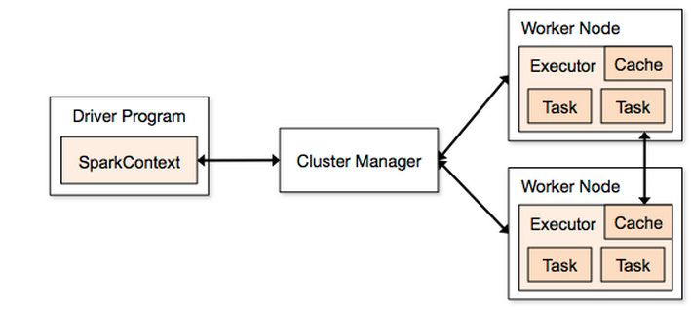
Spark Overview
Large scale cluster computing engine.
Efficient in-memory computations. Key: Spark tries to retain data in memory as much as it can.
Main abstraction of Spark is RDD.
RDD’s have few limitations.
It uses Directed Acyclic Graph to optimize workflow.
Notes:
RDD: object that represents a dataset, way to store keyValue pair
Limitation: no optimizer, structures data not handled
Driver program: what is going to happen in your job
Cluster manager: hadoop or its own cluster (MESOS), distribute jobs across workers in parallel
Cache is main key to performance

Slide 3
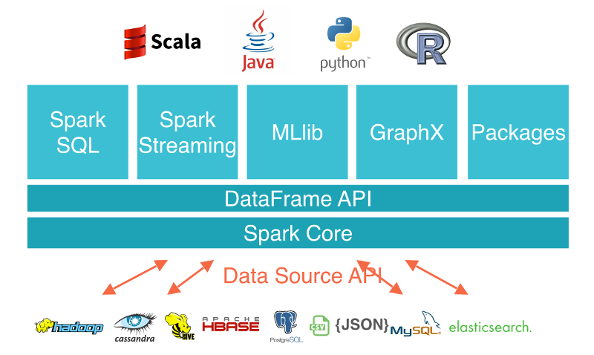
Spark SQL Overview
It is a SQL interface to Spark.
Users can write SQL queries across the cluster.
SQL functions can be used to transform dataset.
Main abstraction of Spark SQL is “DataFrame”:
RDD’s don’t have schema

Slide 4





Why combine Relational & Functional API’s
Relational Processing alone is not enough for big data applications.
Perform ETL, some analysis is hard to do in SQL.
Performing advanced analytics such as Machine Learning.
Functional Programing interface
Relational Processing (e.g., Declarative
Queries)
Automatic Optimization
Notes:
Realtional: select from, where, groupby
Functional: map, count, filter
Functional API: users manipulate RDD’s through operational like Map, Reduce, filter, count.
RDD is a collection of java/py objects portioned across cluster. (page 2. left down)

Slide 5

Why ? / Limitations of
Shark could only be used to query external data storage in Hive Catalog and not for data inside spark program.
Calling shark programs was inconvenient: SQL string generation
Hive was specifically designed for MapReduce i.e. ML could not be implemented.
Notes:
Shark modified apache hive system to run on spark.

Slide 6
Spark SQL Goals
Support Relational Processing both within Spark programs and on external data sources.
DBMS techniques
New Data Sources (by implementing UDF’s)
Enable extension with advanced analytics for ML and Graphs.

Slide 7
Spark SQL Programming Model
SQL interface, accessed through JDBC as well as by using DataFrame API.
DataFrame API –
Performs Relational Operations on both external data sources and Spark’s in-built data collections.
Performs optimization on Relational API.
Catalyst Optimizer –
To reduce the time taken by the query with the help of tree, rules and extension points.
It also helps in adding data sources.
Notes:
RDD is a collection of java/py objects portioned across cluster. (page 2. left down
RDD: object that represents a dataset, way to store keyValue pair

Slide 8
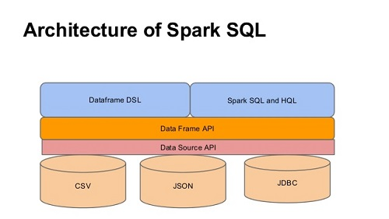
Architecture of Spark SQL
Flexible data access (and store) which works through multiple data formats.
DataSource API:
Reads and store unstructured and semi-structured.
Convert fetched data to dataFrame API
DataFrame API:
Creation of tabular columns.
Dataframes processed by DSL’s or Spark SQL
Source: Internet
Notes:
A dataframe is distributed collection of data organized into named columns.

Slide 9
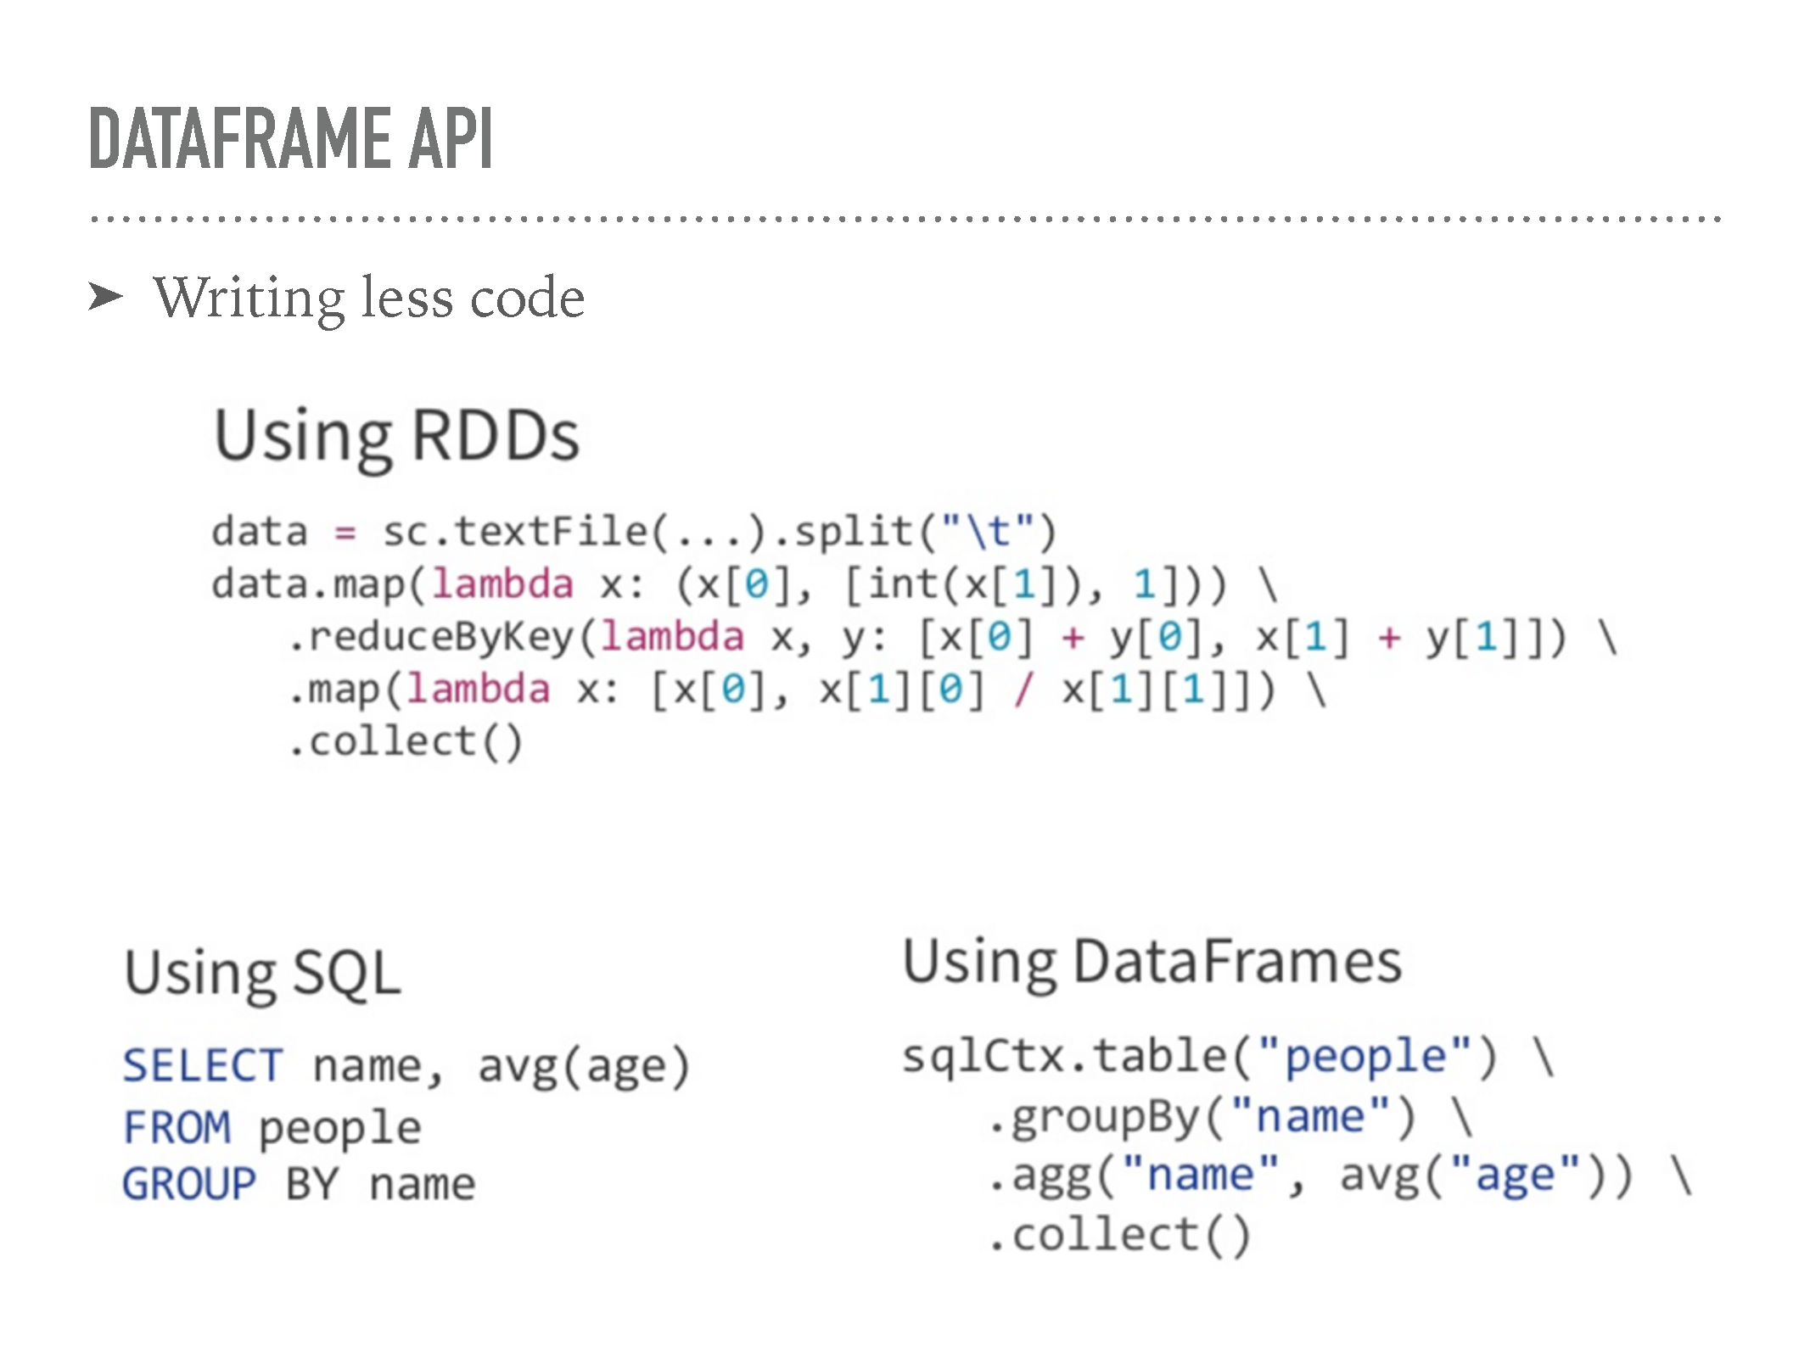
DataFrame API
Idea borrowed from Python Pandas library: Single node tabular data.
RDD + Schema
RDD + additional relational operation such as select few columns, join, aggregation and filter.
Less code:

Slide 10
DataFrame API (Cont.)
Data from various sources such as Hive.
Dataframe creation.
Less code:
Users and young are DataFrames.
Expression is evaluated on DF
Output will be an AST and not some Scala function.
Notes:
Dataframe can be viewed as an RDD of row objects allowing users to call procedural spark API’s such as map.
AST: abstract Syntax Tree

Slide 11
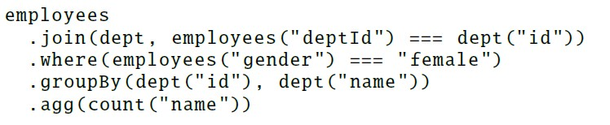
Data Model and DataFrame Operations
DataFrame API supports all major SQL data types, including boolean, integer, double, decimal, string, date, timestamp and also User Defined Data types.
DataFrame Operation examples: Computing the no. of. Female employees in each dept.
Notes:
DF: Employees,
The operators all take expressions objects in limited DSL and let spark capture structure of operations.

Slide 12
Querying Native Datasets
Data from heterogenous sources
Spark SQL let users to create DF directly from an RDD native to programming language.
Reflection is used by Spark SQL to infer schema
Example: Scala defines a DF from users RDD.

Slide 13
In Memory Caching
Spark SQL can use hot data in memory using Columnar storage.
Scan only required columns
Columnar storage in better and reduces memory overhead by applying compression schemes.

Slide 14
UDF’s (User Defined Functions)
Users can create new column based UDF’s according to requirement in Spark SQL.
Eg: No function in Spark SQL for converting string to lower case, create a new function.
UDF must be registered with a list of columns.
MYSQL relies on UDF’s to provide support for JSON files.

Slide 15
Catalyst Optimizer
Relational algebra + expressions: Ability to add new optimization techniques and features to Spark SQL.
Ability for external developers to extend the optimizer by adding new specific rules
It is constructed in Scala offering features such as Pattern Matching.
Main goal: Converting the AST from dataset API (Logical plan) to Query plan (Physical plan).
Logical plan is a tree representing data and schema
Physical plan is the way in which query is executed

Slide 16
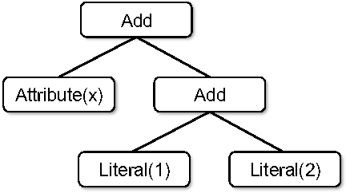
Catalyst Library: Tree
Tree is processed inside catalyst.
Node classes:
Scala code generated by using classes:
Trees use .transform function to implement rules to the nodes.
Note: These classes can be used to create the expression x + (1 + 2)

Slide 17
Catalyst Library: Rules
Trees can be modified by the rules.
New tree is generated every time a rule is enforced.
Rules use pattern matching approach. It finds and replaces subtrees with the specific structure.
A new tree is obtained with expression (x + 3)

Slide 18
Catalyst Library Summed up
Scala code generated by using classes:
Add
Attribute(x)
Literal (3)
Notes:
Only part of tree which matches to rule are replaced

Slide 19
Catalyst Optimizer in Spark SQL
Analysis
Logical Optimization
Physical Planning
Code Generation

Slide 20
Catalyst Optimizer in Spark SQL
Analysis – Analyze the logical plan to resolve references. Validate the columns name etc.
Catalog: represents data source and schema or query
Logical Optimization – Apply standard Scala features like Constant folding, Null propagation, Projection pruning etc.
E.g. Apply/Add rules on trees
Notes:
Constant folding: run everything at the same time
Prunning: select only specific columns

Slide 21
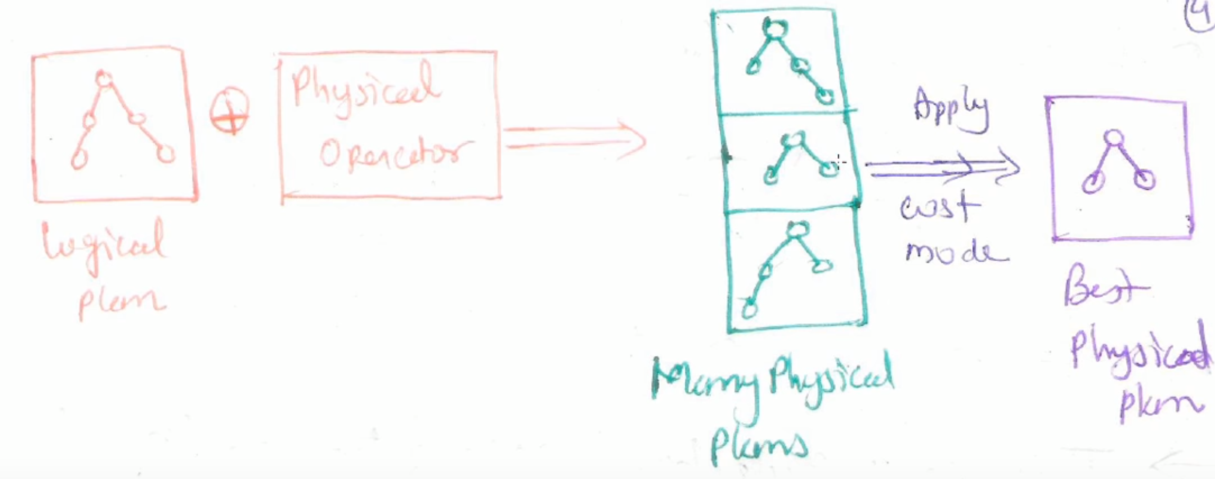
Catalyst Optimizer in Spark SQL
Physical Planning – How the tree should be executed.
Cost based
Check for less utilization of resources.
E.g. Broadcast join

Slide 22
Catalyst Optimizer in Spark SQL
Code Generation – Spark is written in Scala, and Scala is written in JAVA.
“Quassiquotes” are used to construct an AST that can be fed into compiler to generate bytecode for JVM.

Slide 23
Advanced Analytical Features
Schema Interface for Semi-structured devices –
Processing unstructured data causes slow down in code runtime.
JSON input is difficult for Spark and MapReduce.
JSON data source automatically infers a schema from set of records
Notes:
The algorithm finds the most specific spark SQL data type that matches observed instances of the field.

Slide 24
Advanced Analytical Features
Integration with Spark’s official Machine Learning Library (MLLib) –
Pipelines (DataFrame API) are being used in MLlib.
Pipeline offers model training, feature extraction etc.
MLlib created UDT’s (for vectors) to use Spark SQL.

Slide 25
Evaluation
SQL Query Performance & SQL Program Performance was measured.
System used:
6 EC2 i2.Xlarge Machines each with 4 cores
30GB memory, 800GB SSD, Dataset – 110GB (Web analytics)
Performance of Query execution on Spark SQL (using spark 1.3) was compared against:
Shark 0.9.1 – First attempt to run SQL on spark
Impala 2.1.1 – Massive parallel processing SQL query engine

Slide 26
Spark SQL Performance
4 different queries (Scan, Aggregation, Join, UDF (MapReduce))
Queries with different parameters varying with selectivity
1a, 2a, 3a – most selective; 1c, 2c, 3c – least selective (more data)
Figure: Performance of Shark, Impala and Spark SQL on big data benchmark queries
Notes:
Selectivity is the Ratio of Unique values in the key column: C has more data so more runtime
Query 4 uses a python based hive UDF not supported by IMPALA.
More selective: less data
Lease selective more data
3A: Impala chooses a better join plan because of the selectivity of the query make the table very small.
More unique values lead to higher selectivity

Slide 27
DataFrame vs Native Spark Code
Catalyst can perform optimization on DF’s better than handwritten code.
Average calculation using Map and Reduce in Py. API for Spark:
Average calculation using DataFrame API:
Notes:
DF API is 12x faster than Py API
Only the physical plane is constructed in Py and all physical execution is compiled down into native spark code as JVM bytecode.

Slide 28
Pipelining Performance
All operations are written in a single program and pipelining computation across relational and procedural programming.
DataFrame approach also improved the performance with the benefit of Runtime.
Notes:
Disjoint: Separate sql query followed by a scala based spark job.
SPARKSQL: dataframe

Slide 29
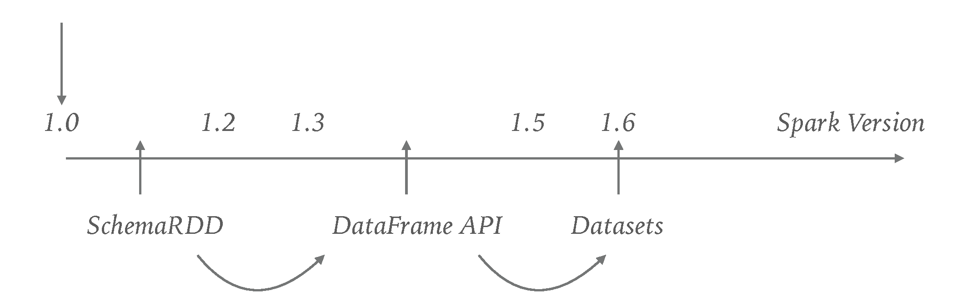
Conclusion
Expose many algorithms in all languages as only data conversion is required in Spark SQL.
Richer set of functionality along with improving the performance over previous SQL based techniques by remarkable level.
Finally, applications that combine relational and procedural queries run faster on integrated Spark SQL than by running SQL and procedural code as distinct parallel jobs.
Figure: Spark Evolution

Slide 30
Questions ? / Discussion ?

